Slide 1

Mobile to Cloud offloading techniques
Literature survey
Siddhi vilas sawant
Ece department
832013645

Slide 2
Why the need to offload data on cloud?
Excellent software and hardware architecture.
Designing of mobile device.
There is been exponentially growth in software and hardware architecture of mobile device.
Hardware consumes a lot of power!
Not acceptable by the users.
There hasn’t been a phenomenal research in battery development from past few years.
Hence, the need to offload data on cloud!!!

Slide 3
What is cloud offloading ?
To offload data on a cloud server which is rich in resources in order to process the task or application faster and minimizing the load on the client i.e. mobile devices.
Cloud offloading differs from the traditional client-server architectures.
As it moves the applications or programs to the servers outside the computing environment.
There has been advance research in cloud computing which has given risen to couple of clouds in the sky.
Hence, selecting a right cloud from the sky to offload data is necessary, to get the minimum battery usage and maximum processing speed.

Slide 4
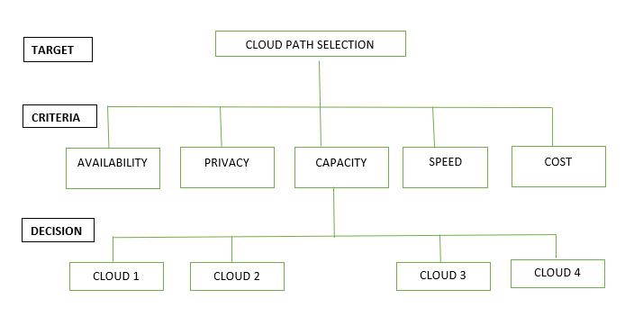
Selecting the best cloud-path
Fig. 1. Hierarchical Structure of Cloud-Path Selection
B. Zhou, A. V. Dastjerdi, R. N. Calheiros, S. N. Srirama and R. Buyya, "mCloud: A Context-Aware Offloading Framework for Heterogeneous Mobile Cloud," in IEEE Transactions on Services Computing, vol. 10, no. 5, pp. 797-810, 1 Sept.-Oct. 2017.

Slide 5
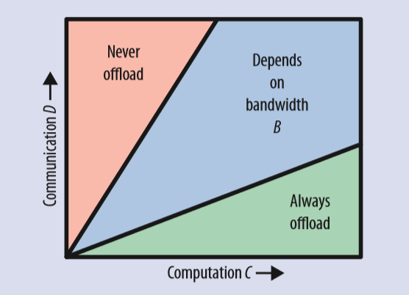

When to offload?
It is been mathematical proved that cloud offloading can reduce the energy consumption of mobile devices
If D/C ratio is low, then the given offloading
will consume less energy.
K.Kumar and Y.-H. Lu, “Cloud computing for mobile users: Can offloading computation save energy?” Computer, vol. 43, 2010.
Offloading is beneficial if D/C is low

Slide 6
Offloading methods
The methods should minimize the latency, battery usage, run-time, maximize the efficiency, provide reliability and security.
Methods are divided into 3-sub categories
Offloading techniques
Scheduling techniques
Security techniques
Few of the offloading methods based on the three categories are reviewed. Some of the techniques can be a combination of offloading and scheduling technique. Thus, providing more reliable and fast processing of task.

Slide 7
Computation offloading
To offload a task’s or application’s code fully or partly on the server.
Two types.
Coarse Grained Offloading method:
Fine grained offloading method:
Depending upon the needs of the user a trade-off between cost and run-time processing is obtained when one of the computation offloading method is adopted.
X.Ma,Y.Cui and I.Stojmenovic “Energy optimizations for mobile terminals via computation offloading,”in Parallel Distributed and Grid Computing (PDGC),pp. 236-241,Solan,6-8 Dec. 2012.

Slide 8
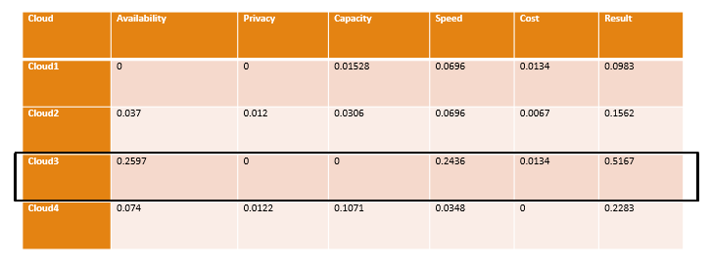
Fuzzy Analytical Hierarchy Process (FAHP)
FAHP has all the functionalities of AHP.
But it also has a membership function µ.
This function defines a transition ranging from 0 to 1.
Evaluation matrix for cloud path selection is obtained and a cloud with highest performance must be used to offload the data. In this case cloud 3 is a suitable cloud to offload the corresponding application.

Slide 9
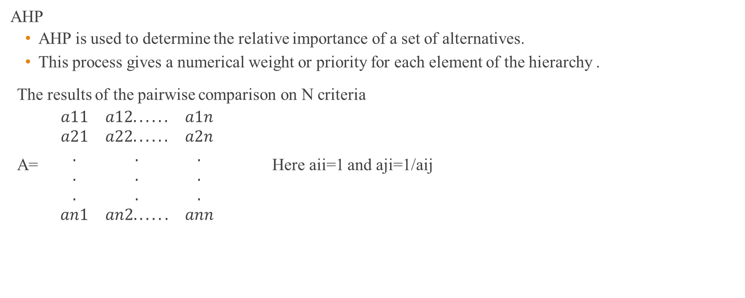
AHP and Fuzzy TOPSIS
AHP
AHP is used to determine the relative importance of a set of alternatives.
This process gives a numerical weight or priority for each element of the hierarchy .
The results of the pairwise comparison on N criteria
A=$\begin{matrix}a11 & a12...... & a1n \\ a21 & a22...... & a2n \\ . & . & . \\ . & . & . \\ . & . & . \\ an1 & an2...... & ann\end{matrix}$ Here aii=1 and aji=1/aij
H. Wu, Q. Wang and K. Wolter, "Methods of cloud-path selection for offloading in mobile cloud computing systems," 4th IEEE International Conference on Cloud Computing Technology and Science Proceedings, Taipei, 2012, pp. 443-448. doi: 10.1109/CloudCom.2012.6427587

Slide 10
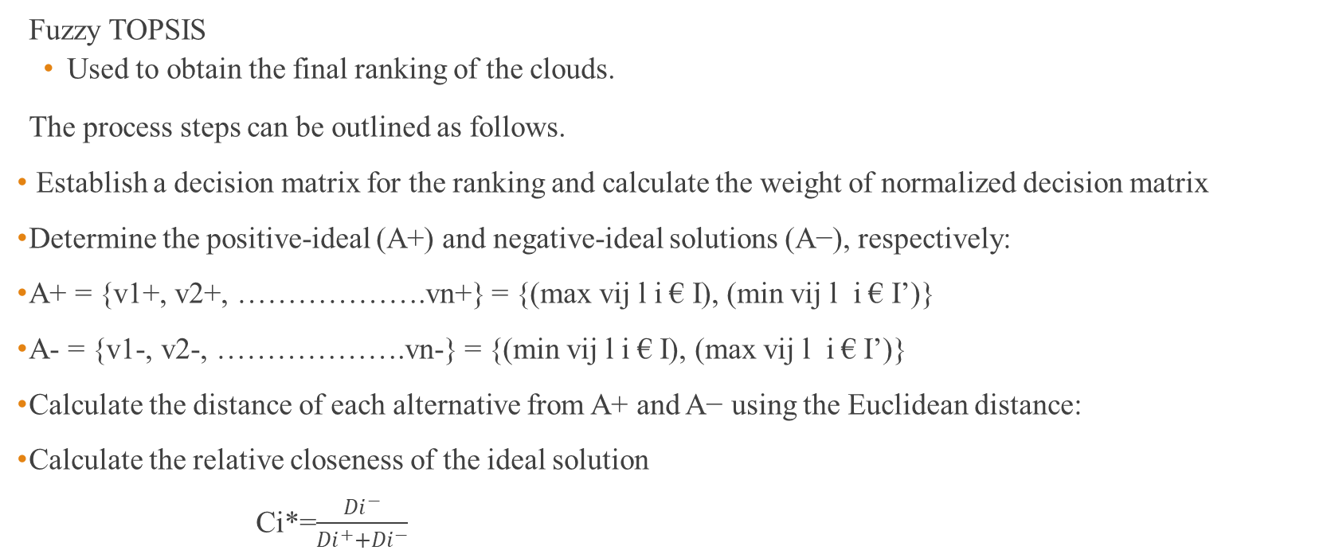
Contd.
Fuzzy TOPSIS
Used to obtain the final ranking of the clouds.
The process steps can be outlined as follows.
Establish a decision matrix for the ranking and calculate the weight of normalized decision matrix
Determine the positive-ideal (A+) and negative-ideal solutions (A−), respectively:
A+ = {v1+, v2+, ……………….vn+} = {(max vij l i € I), (min vij l i € I’)}
A- = {v1-, v2-, ……………….vn-} = {(min vij l i € I), (max vij l i € I’)}
Calculate the distance of each alternative from A+ and A− using the Euclidean distance:
Calculate the relative closeness of the ideal solution
Ci*=$\frac{{Di}^{−}}{{{Di}^{+}+Di}^{−}}$

Slide 11
ThinkAir
Here method level offloading is adopted.
At the server side, to handle computation offloading smartphone virtualization is done.
The smartphone acts like a thin client displaying the received results and saving the battery in process.
Through task distribution support over virtual machine images scalability and elasticity is obtained on the server side in ThinkAir.
Reduction in execution time and energy consumption of applications is attained through parallel processing in ThinkAir.
S. Kosta, A. Aucinas, P. Hui, R. Mortier, and X. Zhang, “Thinkair: Dynamic resource allocation and parallel execution in the cloud for mobilecodeofﬂoading,”inINFOCOM,2012ProceedingsIEEE. IEEE, 2012, pp. 945–953

Slide 12
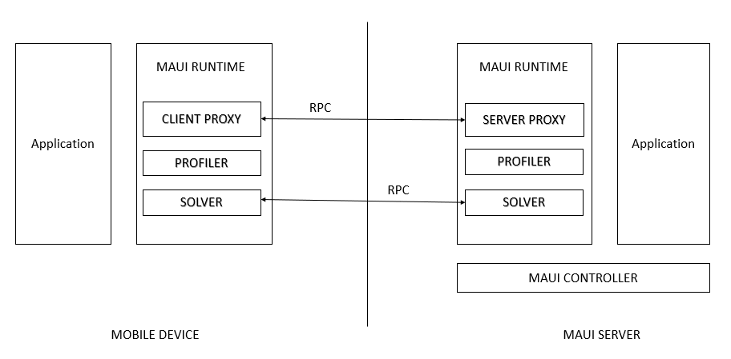
MAUI
To ensure that a user selects best cloud and minimum battery is consumed in the process MAUI profiler is being used.
MAUI profiles the code contained in the functions that are used by the applications and other component known as MAUI profiler
.
Fig MAUI Architecture

Slide 13
Delayed Offloading
Queuing model is used.
Instead of transmitting the offloaded data immediately the data to be offloaded is delayed when the Wi-Fi networks are unavailable.
The delay window depends on two factors i.e. first the expiry of deadline and second the availability of Wi-Fi network.
If one of the mentioned factor holds true, then data is no more delayed.
F. Mehmeti and T. Spyropoulos, “Is it worth to be patient? analysis and optimization of delayed mobile data ofﬂoading,” in INFOCOM 2014, IEEE International Conference on Computer Communications, 27 April-2 May, 2014, Toronto, Canada. IEEE, 2014

Slide 14
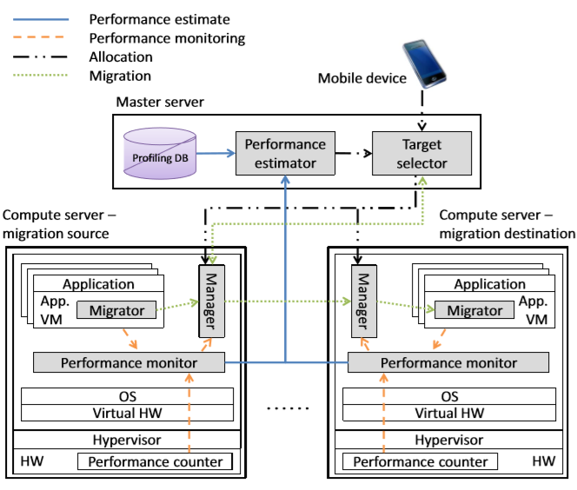
CMcloud
CMcloud Architecture
D. Chae et al., "CMcloud: Cloud Platform for Cost-Effective Offloading of Mobile Applications," 2014 14th IEEE/ACM International Symposium on Cluster, Cloud and Grid Computing, Chicago, IL, 2014, pp. 434-444. doi: 10.1109/CCGrid.2014.75

Slide 15
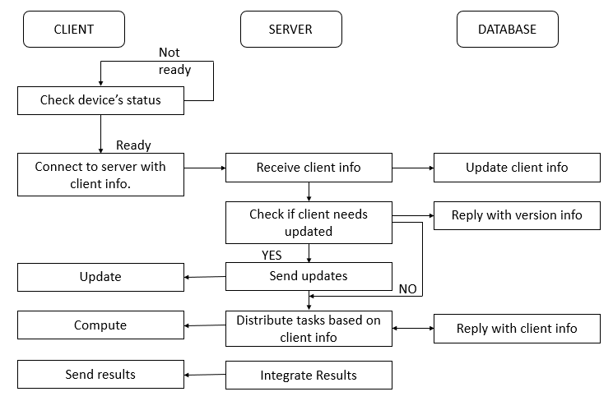
GEM Cloud
This technique saves energy while computing a task on the cloud.
It does so by using scattered mobile devices to process task in parallel and uses server-client protocol.
Flowchart of server-client protocol

Slide 16
Middleware-AURA
To implementing optimization techniques
Changes must be made in application software architecture and complex OS
Necessary to make correct calculations of response time and offloaded energy.
Hence, middleware use is becoming popular!!
Provides energy-efficiency and performance robustness. By utilizing various resources like -type and status of available wireless networks, the capabilities of cloud servers and the application communication/computation intensiveness.
It analyzes data for the network type, app type, cloud capabilities and network conditions by using an unsupervised Q-learning machine learning technique to select an optimal cloud and network type and time to offload.
It is proved that there has been 30% improvement in battery life and 25% better response time as compared to the state-of-the-art fuzzy logic based offloading approach.
A. Khune, S. Pasricha, “Mobile Network-Aware Middleware Framework for Energy Efficient Cloud Offloading of Smartphone Applications”, to appear, IEEE Consumer Electronics, 2017

Slide 17
IGAFCM
Extension of FCM, the algorithm consists of three parts
Resource Clustering
Resource Scheduling
Score Matching
The IGAFCM has a good convergence required for re-clustering of resources that in the process has more speed in comparison with the traditional FCM algorithm.
The reason it works better than the FCM because genetic algorithm finds the approximate center for global search instead of finding the local optimal solutions.
W. Hong-Qiang, L. Xiao-Yong, F. Bin-Xing and W. Yi-Ping, "Resource Scheduling Based on Improved FCM Algorithm for Mobile Cloud Computing," 2016 IEEE 22nd International Conference on Parallel and Distributed Systems (ICPADS), Wuhan, 2016, pp. 128-132.

Slide 18
VariedLen Algorithm
As in real world - the job requests won’t be of fixed lengths and finished within the stipulated time frame as assumed by the Lyapunov technique.
Hence an extended version of Lyapunov technique is implemented and new algorithm- VariedLen is proposed.
For job requests varying in lengths this algorithm makes online decisions in consecutive time.
Pros: 1. Maintains low congestion.
2. Strong system stability.
3. Gives (1/v) diminishing gap for the MSP for time average profit.
W. Hong-Qiang, L. Xiao-Yong, F. Bin-Xing and W. Yi-Ping, "Resource Scheduling Based on Improved FCM Algorithm for Mobile Cloud Computing," 2016 IEEE 22nd International Conference on Parallel and Distributed Systems (ICPADS), Wuhan, 2016, pp. 128-132.

Slide 19
ROSAC
First, from the received task Ti the cloud retrieves the asymptotic complexity Ci.
This information is used and precomputed with its task profile and determines T’i ⊂ Ti.
The estimated runtime of all the Ti’s are same and only they are considered for computation.
Further the Ti are divided into subtasks and distributed depending upon the computing power of the devices in their allocated resource pool.
The same procedure is repeated for the remaining portion of task. Thus, addressing multiple tasks.
S. Noor and R. Hasan, "ROSAC: A Round-Wise Fair Scheduling Approach for Mobile Clouds Based on Task Asymptotic Complexity," 2017 5th IEEE International Conference on Mobile Cloud Computing, Services, and Engineering (MobileCloud), San Francisco, CA, 2017, pp. 60-65.

Slide 20
Non-biometric authentication
Authorization token is generated for a single access to resources.
It consists of two parts- Identity management system(IMS) generates a token and sends it to user and cloud and cloud generates one more token and sends it to the user.
The token send by IMS and to user to/by cloud are stored in cloud database.
When the user logins in the server by passing the two tokens obtained from IMS and cloud the cloud compare them with these tokens within the database. To authenticate the user or not.
.
Azeem Ahmad, Muhammad Mustafa Hassan, Abdul Aziz,” A Multi-Token Authorization Strategy for Secure Mobile Cloud Computing” 2014 2nd IEEE International Conference on Mobile Cloud Computing, Services, and Engineering

Slide 21
Bio-Metric Authentication
Fingerprint image is captured by the mobile phone camera used as biometric sensor.
The captured image is stored in the cloud database whenever the user wants to access or offload data it must go through validation process.
It is done by scanning the fingerprint. If the user’s fingerprint matches with the fingerprint in the database, access is proved otherwise not.
To improve the key generation process in traditional biometric algorithm, done by extracting minutiae points from the image.
A new distance based key generation algorithm is proposed where Centroid C for the given fingerprint image is identified. By using this algorithm key is be generated.
It simplifies the process of generating the crypto keys as compared to the traditional algorithm.
This improved version of algorithm can be used for authentication of user to access services on cloud.
R Ranjan, Sanjay Kumar Singh,” Improved and Innovative Key Generation Algorithms for Biometric Cryptosystems” 2013 3rd IEEE International Advance Computing Conference (IACC)
IehabALRassan, HananAlShaher,” Securing Mobile Cloud Using Finger Print Authentication” International Journal of Network Security & Its Applications (IJNSA), Vol.5, No.6, November 2013

Slide 22
Conclusion
Mobile to cloud offloading has a great scope increasing the battery life of the mobile devices by outsourcing the task on the third-party server i.e. cloud.
These servers not only consume less power but also process the task in less time and procure the correct results.
Along with that the advantages of offloading are- lower bandwidth requirements, data charges and usage.

Slide 23
Contd.
But there few limitations to this technique.
First, the three factors that act as a barrier to adoption of MCC are privacy, security and trust.
Second, environmental uncertainty- due to changes in environment access the resources of won’t be always feasible and reliable.
Lastly, adoption of this technique in day to day by people.
Hence, techniques that not all provide reliable connection and minimum battery usage but also which ensures the user that the uploaded data is in safe hand by using a high end encrypting algorithm and easy to use and adopt should be researched.

Slide 24
THANK-YOU

